Slide 1
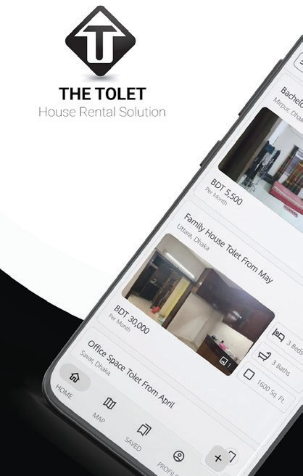



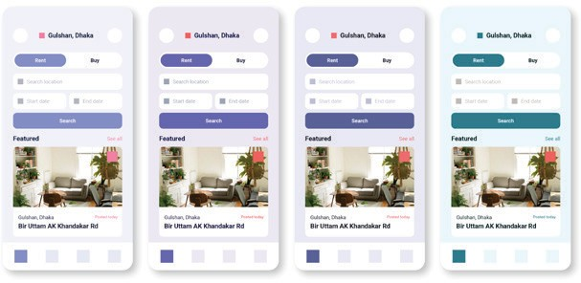


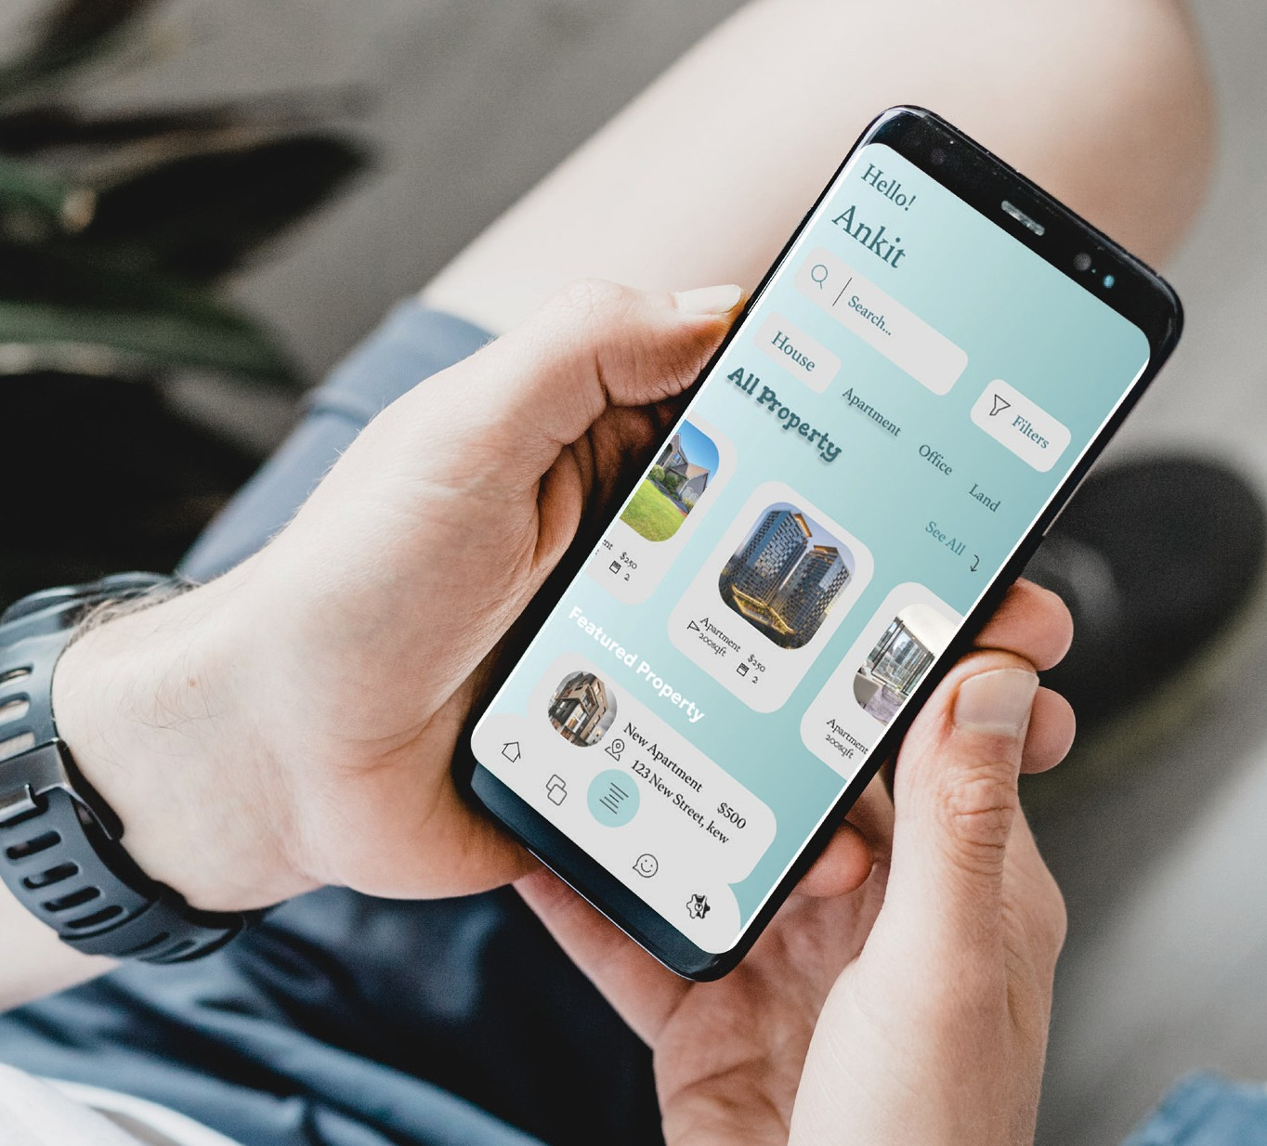
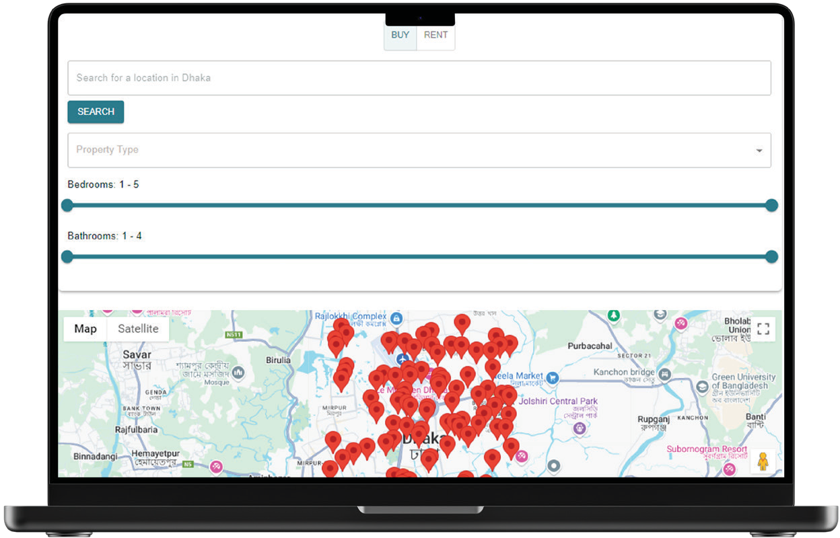
REAL ESTATE APP
PROBLEM
The real estate market in Bangladesh faces inefficiencies due to the lack of a centralized platform with real-time features, such as interactive maps and user verification
Current platforms like “Tolet” and “BD Housing” lack crucial functionality, making property transactions challenging and unreliable.
SOLUTION
The solution involves developing a mobile and web platform using AWS for scalability, MySQL for managing listings, and Kotlin for Android development. The platform integrates real- time features such as map-based searches and secure user verification using MFA and
CAPTCHA. The architecture is designed to ensure scalability, security, and high performance.
PLANS
Profile Creation
Enable professionals to build detailed profiles
Property Listings & Quoting
Allow users to post properties and receive quotes
Enhanced Search Features
Incorporate real-time map-based search and
filtering options
Account Verification
Secure the system with MFA and CAPTCHA
DEVELOPMENT
User Research & Surveys
Extensive user research was conducted to understand user preferences and needs in the Bangladeshi real estate market. Surveys collected feedback on critical features like
interactive maps, search functionality, and user verification
Color Research
Research was performed to determine an appropriate color scheme to enhance the user experience
PROGRESS SO FAR
User Registration & Login
Basic functionality for user sign-up and login is
implemented
Property Listings Users can create property listings, search, and filter results based on location and price
Backend Setup AWS services such as Lambda, RDS, and S3 are integrated for scalable and secure operations
Frontend Design Initial UI for web and mobile apps is completed, with integration of map-based property searches
FUTURE PLANS
Security Enhancements
Implement data encryption and further strengthen security measures like CAPTCHA and MFA
Real-Time Messaging
Add messaging between users and real estate professionals
Property Verification
Implement processes to verify properties and user reviews

